Slide 1


Streaming Periodicity with Mismatches
Funda Ergun,
Elena Grigorescu,
Erfan Sadeqi Azer,
Samson Zhou

Slide 2
Periodicity
A portion of a string that repeats
ABCDABCDABCDABCD
ABCDABCDABCDABCD

Slide 3
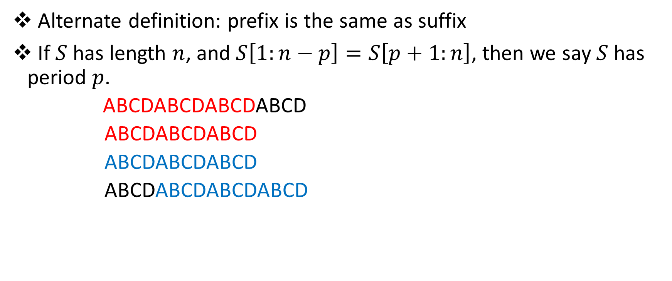
Periodicity
Alternate definition: prefix is the same as suffix
If $S$ has length $n$, and $S\left[1:n−p\right]=S\left[p+1:n\right]$, then we say $S$ has period $p$.
ABCDABCDABCDABCD
ABCDABCDABCD
ABCDABCDABCD
ABCDABCDABCDABCD

Slide 4
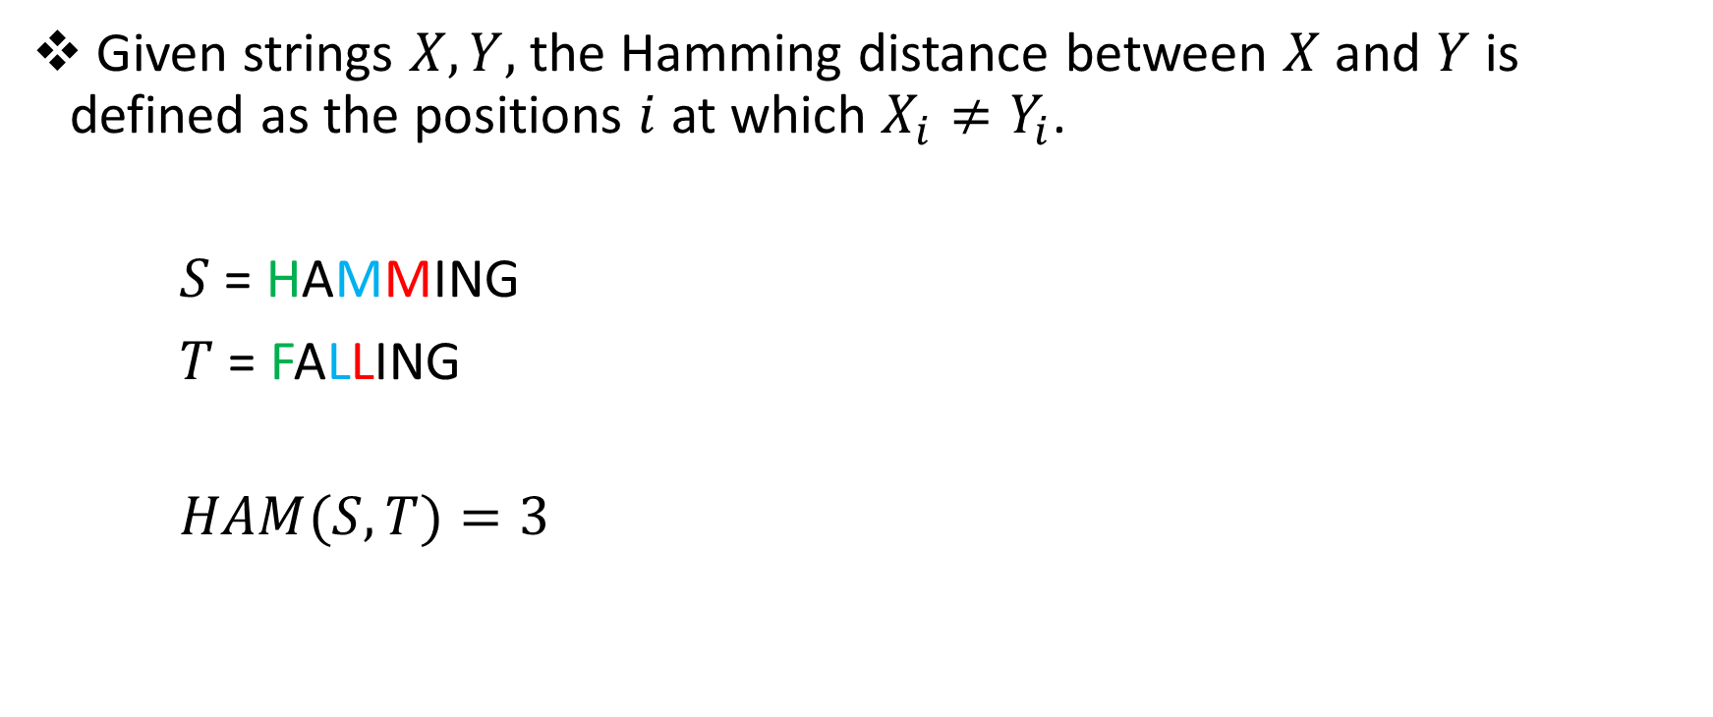
Hamming Distance
Given strings $X, Y,$ the Hamming distance between $X$and $Y$ is defined as the positions $i$ at which $X_{i}≠Y_{i}$.
$S$ = HAMMING
$T$ = FALLING
$HAM(S,T)=3$

Slide 5
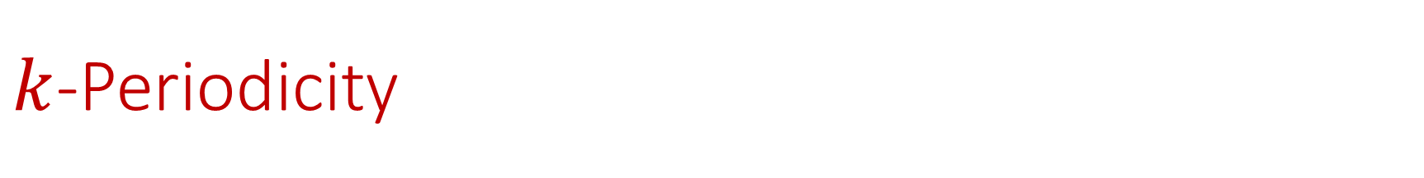
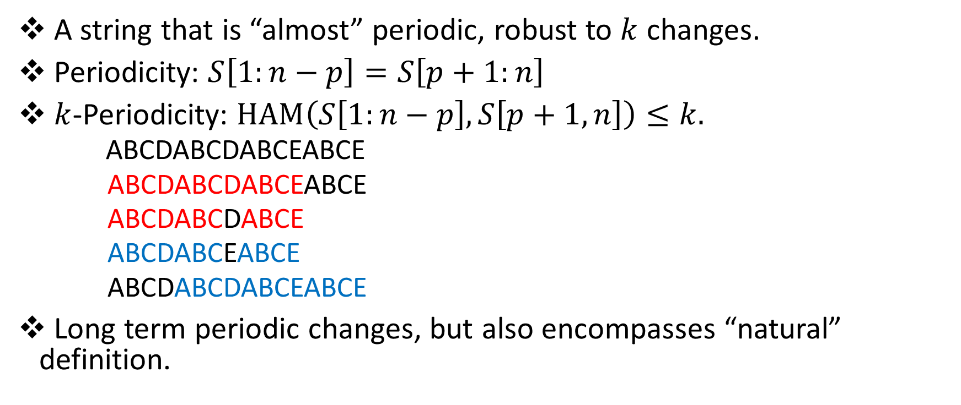
$k$-Periodicity
A string that is “almost” periodic, robust to $k$ changes.
Periodicity: $S\left[1:n−p\right]=S\left[p+1:n\right]$
$k$-Periodicity: $HAM\left(S\left[1:n−p\right],S\left[p+1,n\right]\right)≤k.$
ABCDABCDABCEABCE
ABCDABCDABCEABCE
ABCDABCDABCE
ABCDABCEABCE
ABCDABCDABCEABCE
Long term periodic changes, but also encompasses “natural” definition.
1-period: 4

Slide 6

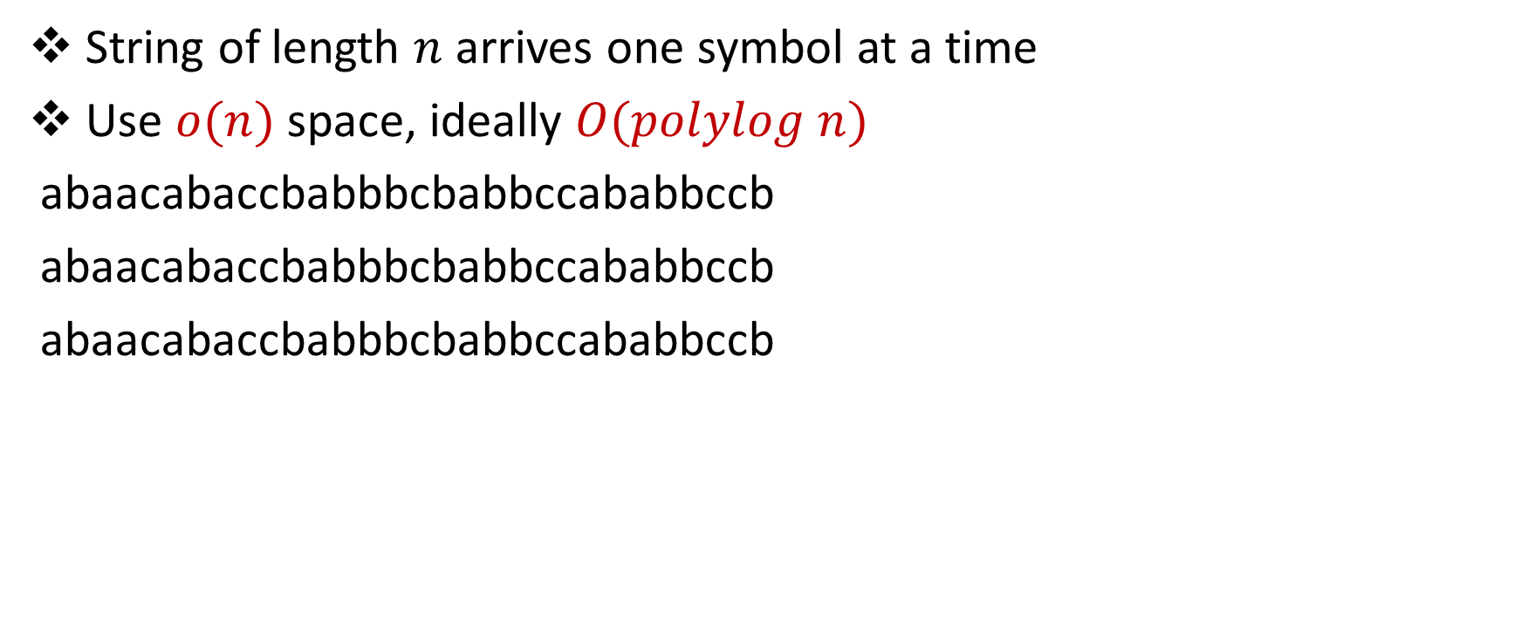
Streaming Model
String of length $n$ arrives one symbol at a time
Use $o(n)$ space, ideally $O(polylog n)$
abaacabaccbabbbcbabbccababbccb
abaacabaccbabbbcbabbccababbccb
abaacabaccbabbbcbabbccababbccb

Slide 7
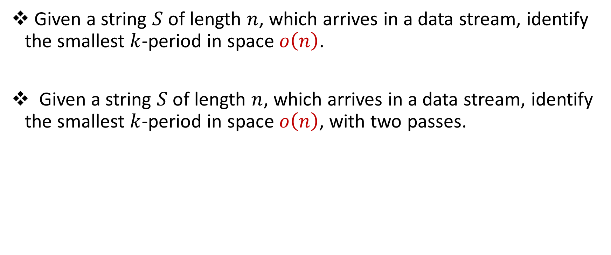
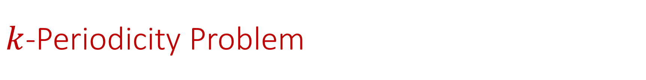
$k$-Periodicity Problem
Given a string $S$ of length $n$, which arrives in a data stream, identify the smallest $k$-period in space $o\left(n\right)$.
Given a string $S$ of length $n$, which arrives in a data stream, identify the smallest $k$-period in space $o\left(n\right)$, with two passes.

Slide 8
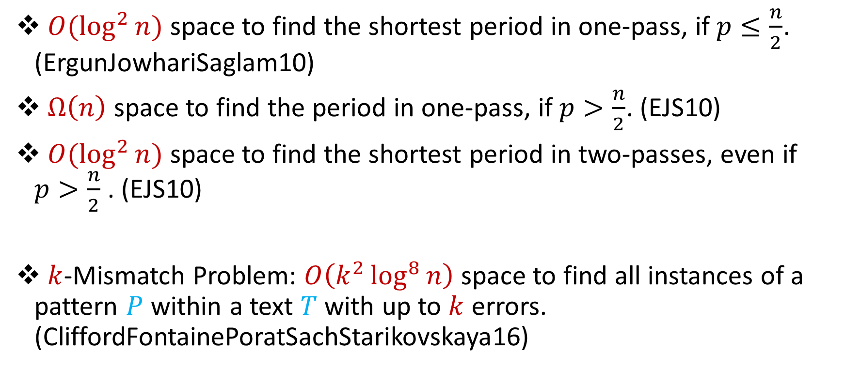
Related Work
$O(\log^{2}{n)}$ space to find the shortest period in one-pass, if $p≤\frac{n}{2}$. (ErgunJowhariSaglam10)
$Ω\left(n\right)$ space to find the period in one-pass, if $p>\frac{n}{2}$. (EJS10)
$O(\log^{2}{n)}$ space to find the shortest period in two-passes, even if $p>\frac{n}{2}$. (EJS10)
$k$-Mismatch Problem: $O\left(k^{2}\log^{8}{n}\right)$ space to find all instances of a pattern $P$ within a text $T$ with up to $k$ errors. (CliffordFontainePoratSachStarikovskaya16)

Slide 9
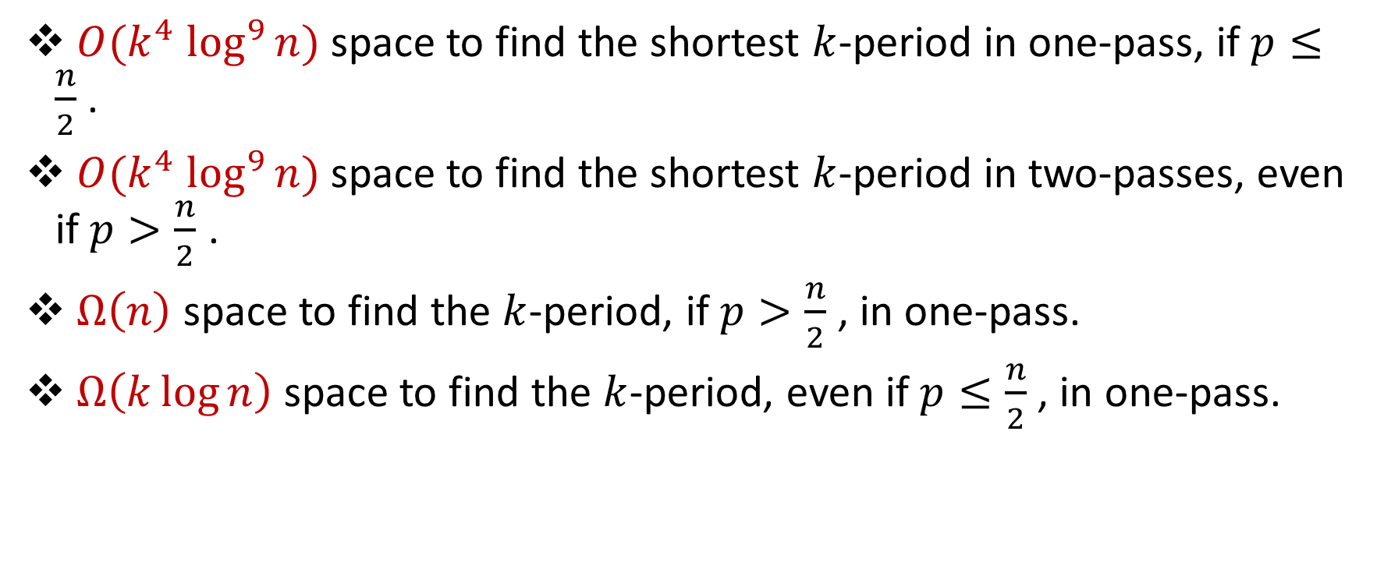
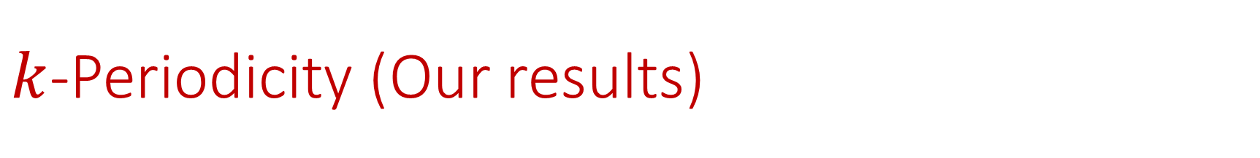
$k$-Periodicity (Our results)
$O({k^{4} log}^{9}{n)}$ space to find the shortest $k$-period in one-pass, if $p≤\frac{n}{2}$ .
$O({k^{4} log}^{9}{n)}$ space to find the shortest $k$-period in two-passes, even if $p>\frac{n}{2}$ .
$Ω\left(n\right)$ space to find the $k$-period, if $p>\frac{n}{2}$ , in one-pass.
$Ω\left(k\log{n}\right)$ space to find the $k$-period, even if $p≤\frac{n}{2}$ , in one-pass.

Slide 10
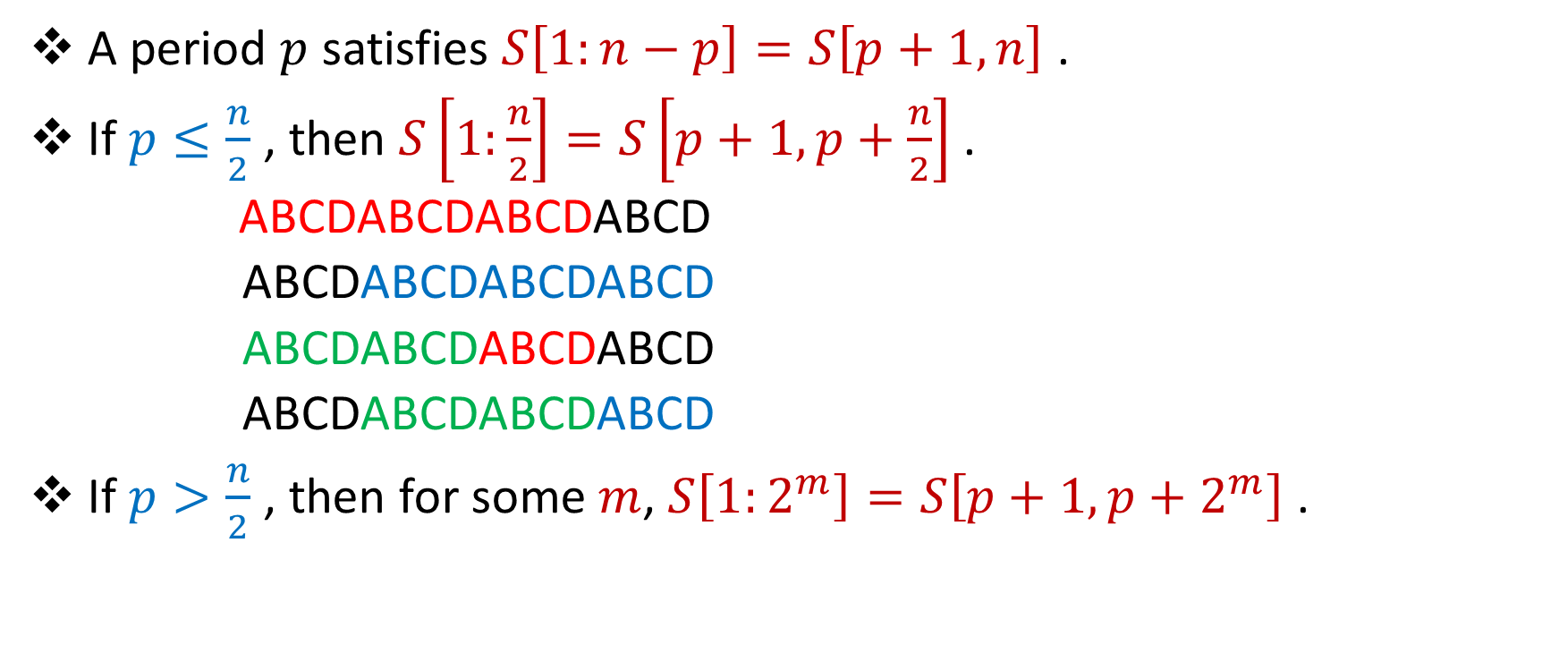
Ideas from Streaming Periodicity
A period $p$ satisfies $S\left[1:n−p\right]=S\left[p+1,n\right]$ .
If $p≤\frac{n}{2}$ , then $S\left[1:\frac{n}{2}\right]=S\left[p+1,p+\frac{n}{2}\right]$ .
ABCDABCDABCDABCD
ABCDABCDABCDABCD
ABCDABCDABCDABCD
ABCDABCDABCDABCD
If $p>\frac{n}{2}$ , then for some $m$, $S\left[1:2^{m}\right]=S\left[p+1,p+2^{m}\right]$ .

Slide 11

Karp-Rabin Fingerprints
Given base $B$and a prime $P$, define $φ\left(S\right)=\sum_{i=1}^{n}{B^{i}S\left[i\right] \left(mod P\right)}$
If $S=T$, then $φ\left(S\right)=φ\left(T\right)$
If $S≠T$, then $φ\left(S\right)≠φ\left(T\right)$ w.h.p. (Schwartz-Zippel)

Slide 12
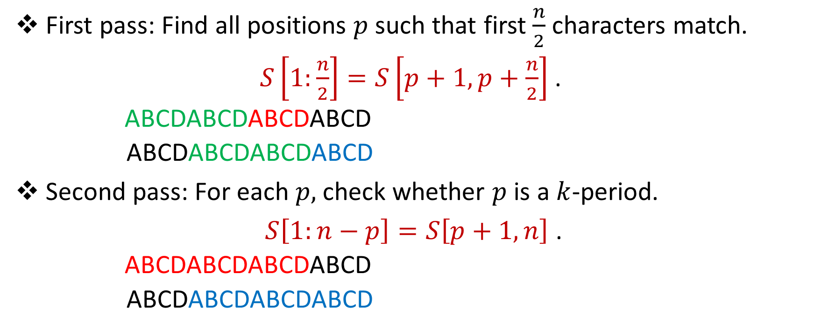
Ideas from Streaming Periodicity
First pass: Find all positions $p$such that first $\frac{n}{2}$ characters match.
$S\left[1:\frac{n}{2}\right]=S\left[p+1,p+\frac{n}{2}\right]$ .
ABCDABCDABCDABCD
ABCDABCDABCDABCD
Second pass: For each $p,$ check whether $p$ is a $k$-period.
$S\left[1:n−p\right]=S\left[p+1,n\right]$ .
ABCDABCDABCDABCD
ABCDABCDABCDABCD

Slide 13
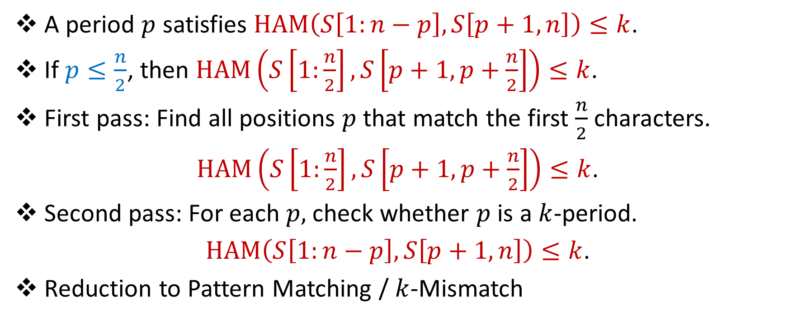
Overall Idea
A period $p$ satisfies $HAM\left(S\left[1:n−p\right],S\left[p+1,n\right]\right)≤k$.
If $p≤\frac{n}{2}$, then $HAM\left(S\left[1:\frac{n}{2}\right],S\left[p+1,p+\frac{n}{2}\right]\right)≤k$.
First pass: Find all positions $p$ that match the first $\frac{n}{2}$ characters.
$HAM\left(S\left[1:\frac{n}{2}\right],S\left[p+1,p+\frac{n}{2}\right]\right)≤k$.
Second pass: For each $p,$ check whether $p$ is a $k$-period.
$HAM\left(S\left[1:n−p\right],S\left[p+1,n\right]\right)≤k$.
Reduction to Pattern Matching / $k$-Mismatch

Slide 14


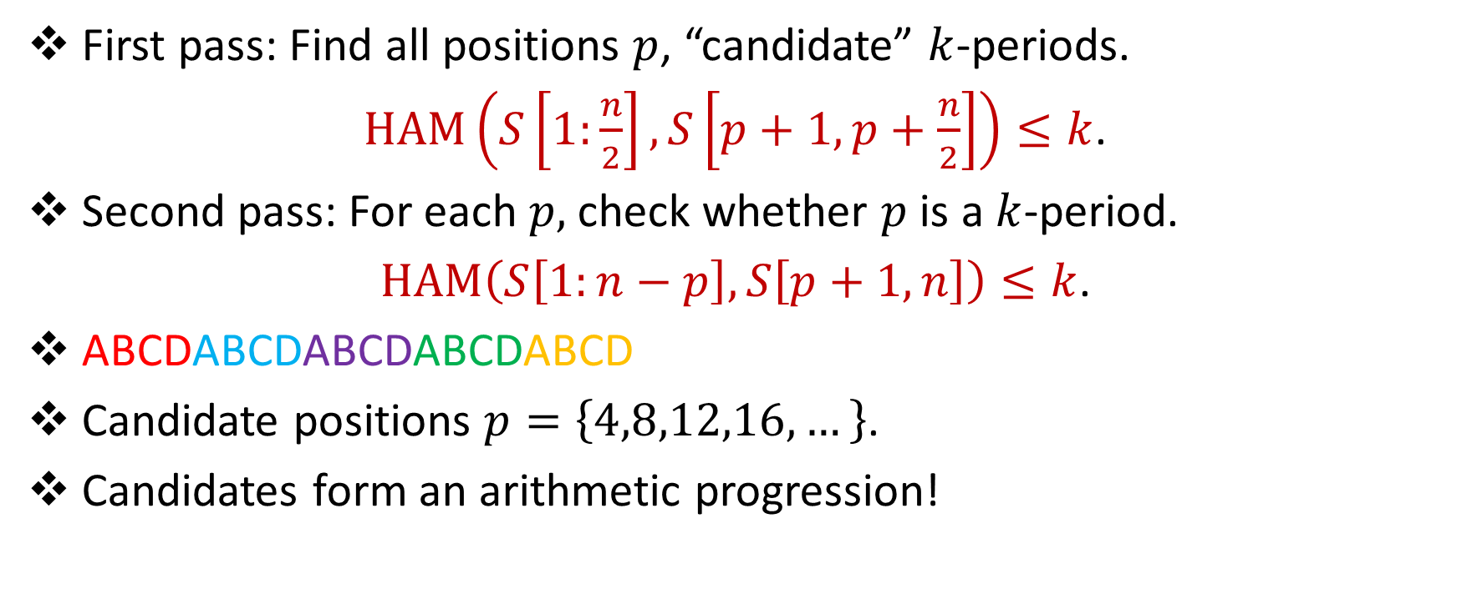
First Pass to Second Pass?
First pass: Find all positions $p$, “candidate” $k$-periods.
$HAM\left(S\left[1:\frac{n}{2}\right],S\left[p+1,p+\frac{n}{2}\right]\right)≤k$.
Second pass: For each $p,$ check whether $p$ is a $k$-period.
$HAM\left(S\left[1:n−p\right],S\left[p+1,n\right]\right)≤k$.
ABCDABCDABCDABCDABCD
Candidate positions $p=\left\{4,8,12,16,…\right\}$.
Candidates form an arithmetic progression!

Slide 15
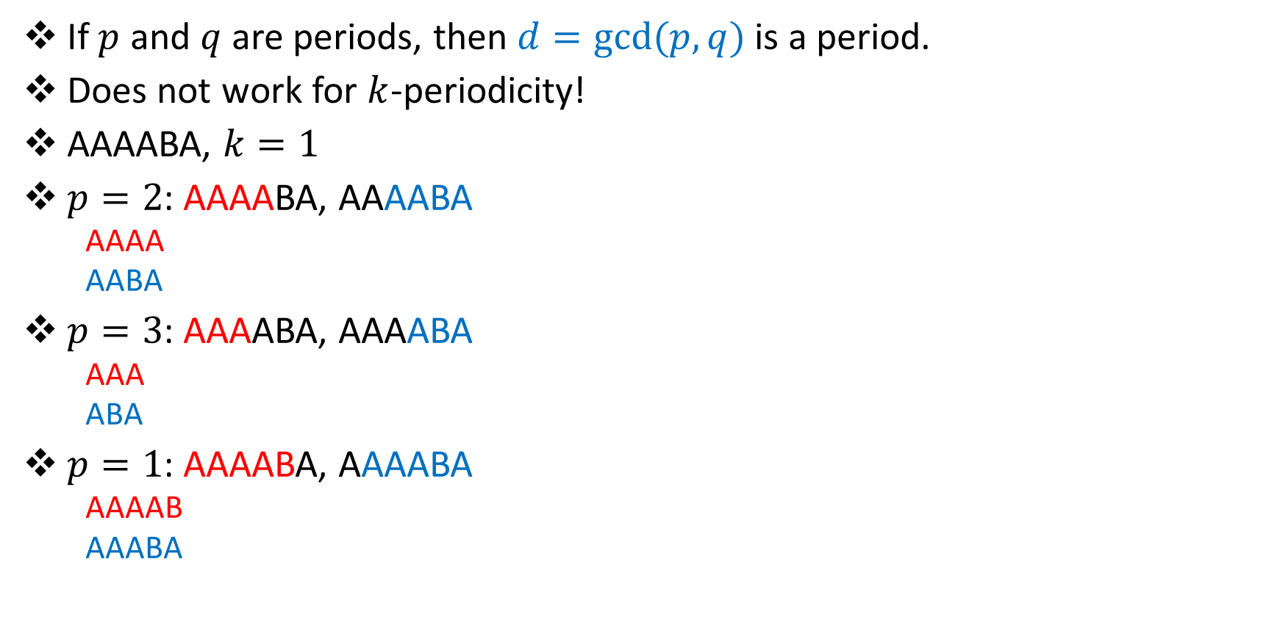
First Pass to Second Pass?
If $p$ and $q$ are periods, then $d=gcd(p,q)$ is a period.
Does not work for $k$-periodicity!
AAAABA, $k=1$
$p=2$: AAAABA, AAAABA
AAAA
AABA
$p=3$: AAAABA, AAAABA
AAA
ABA
$p=1$: AAAABA, AAAABA
AAAAB
AAABA
1 mismatch
1 mismatch
2 mismatches!

Slide 16
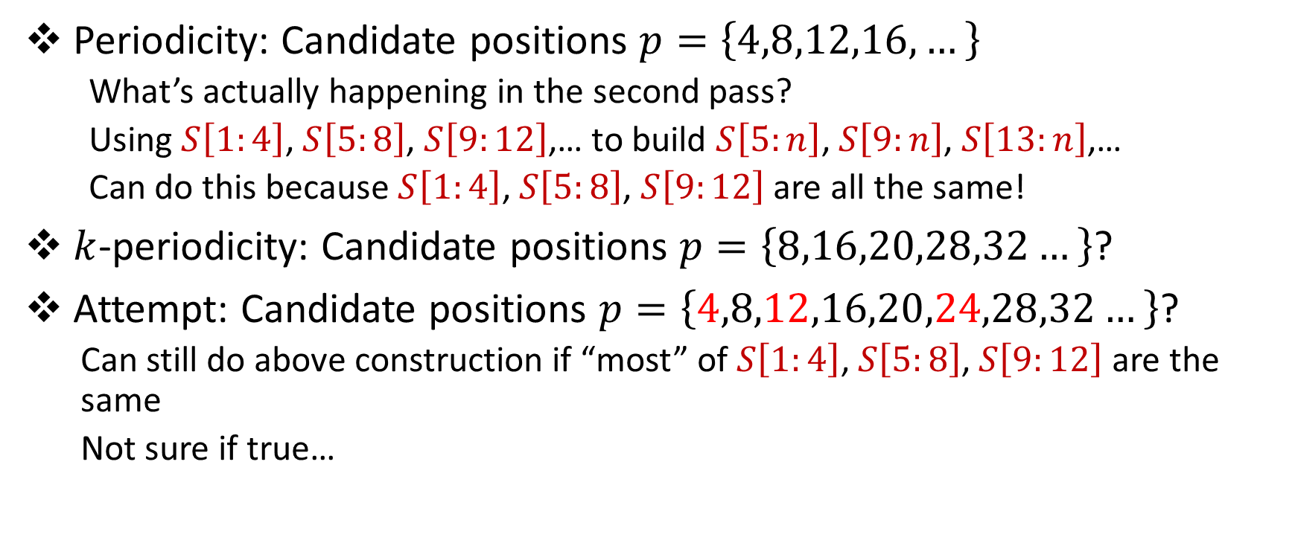
First Pass to Second Pass?
Periodicity: Candidate positions $p=\left\{4,8,12,16,…\right\}$
What’s actually happening in the second pass?
Using $S\left[1:4\right]\text{,} S\left[5:8\right]$, $S\left[9:12\right]$,… to build $S\left[5:n\right]\text{,} S\left[9:n\right]$, $S\left[13:n\right]$,…
Can do this because $S\left[1:4\right]\text{,} S\left[5:8\right]$, $S\left[9:12\right]$ are all the same!
$k$-periodicity: Candidate positions $p=\left\{8,16,20,28,32…\right\}$?
Attempt: Candidate positions $p=\left\{4,8,12,16,20,24,28,32…\right\}$?
Can still do above construction if “most” of $S\left[1:4\right]\text{,} S\left[5:8\right]$, $S\left[9:12\right]$ are the same
Not sure if true…

Slide 17
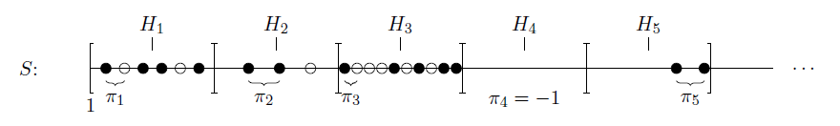

First Pass to Second Pass?
Candidates $p=\left\{8,16,20,27,30,39,45,55\right\}$?
Candidates $p=\left\{8,12,16,20\},\left\{27,30,33,36,39\right\},\{45,50,55\right\}$

Slide 18


Structural Results
If $p$ and $q$ are periods, then $d=gcd(p,q)$ is a period.
If $p$ and $q$ are “small”, then $d=gcd(p,q)$ is a $O(k^{2})$-period.
At most $O\left(k^{2}\right)$ of the substrings $S\left[1:d\right],$ $S\left[d+1:2d\right],$ $S\left[2d+1:3d\right],$ can be different

Slide 19







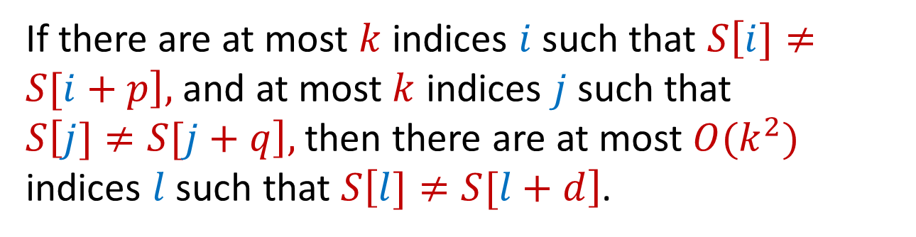
Structural Results
If $p$ and $q$ are “small”, then $d=gcd(p,q)$ is a $O(k^{2})$-period.
Consider the indices as a grid.
If there are at most $k$ indices $i$ such that $S\left[i]≠S[i+p\right],$ and at most $k$ indices $j$ such that $S\left[j]≠S[j+q\right],$ then there are at most $O(k^{2})$ indices $l$ such that $S\left[l]≠S[l+d\right]$.
$$i+p$$
$$i−q$$
$$i$$
$$i+q$$
$$i−p$$

Slide 20






Structural Results
…AABAAABCCAA…
$p=3, q=7$
Bound the number of indices $l$ such that $S\left[l]≠S[l+d\right]$.
$$i+p$$
A
A
A
C
$$i−q$$
$$i$$
$$i+q$$
$$i−p$$

Slide 21
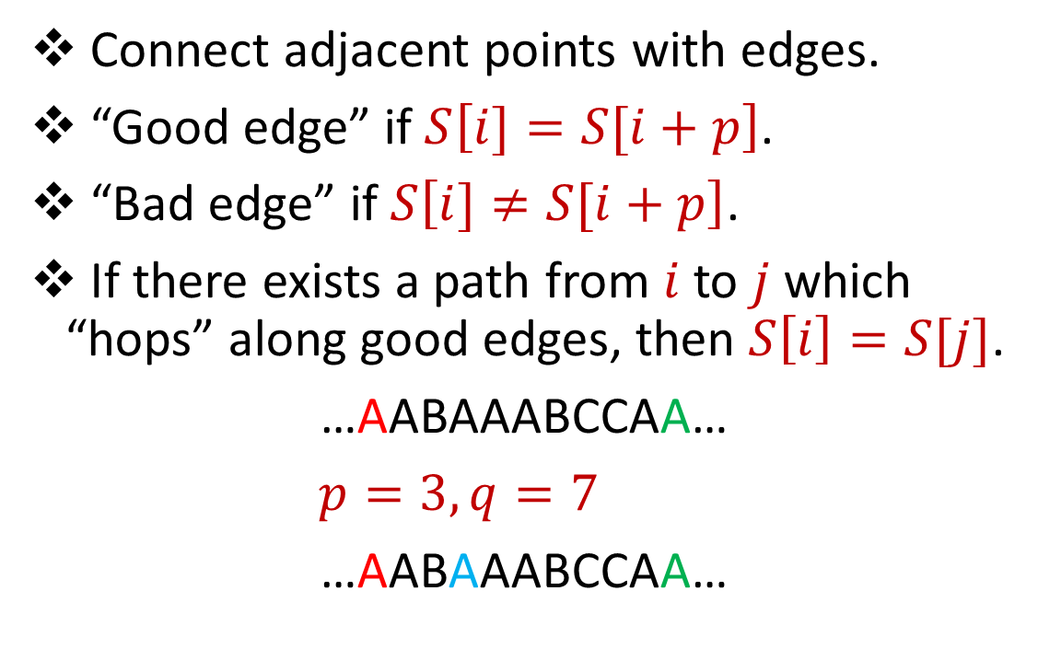

Structural Results
Connect adjacent points with edges.
“Good edge” if $S\left[i]=S[i+p\right]$.
“Bad edge” if $S\left[i]≠S[i+p\right]$.
If there exists a path from $i$to $j$ which “hops” along good edges, then $S\left[i\right]=S[j]$.
…AABAAABCCAA…
$p=3, q=7$
…AABAAABCCAA…
$$i+p$$
$$i+p+q$$
$$i−q$$
$$i$$
$$i+q$$
$$i−p$$

Slide 22

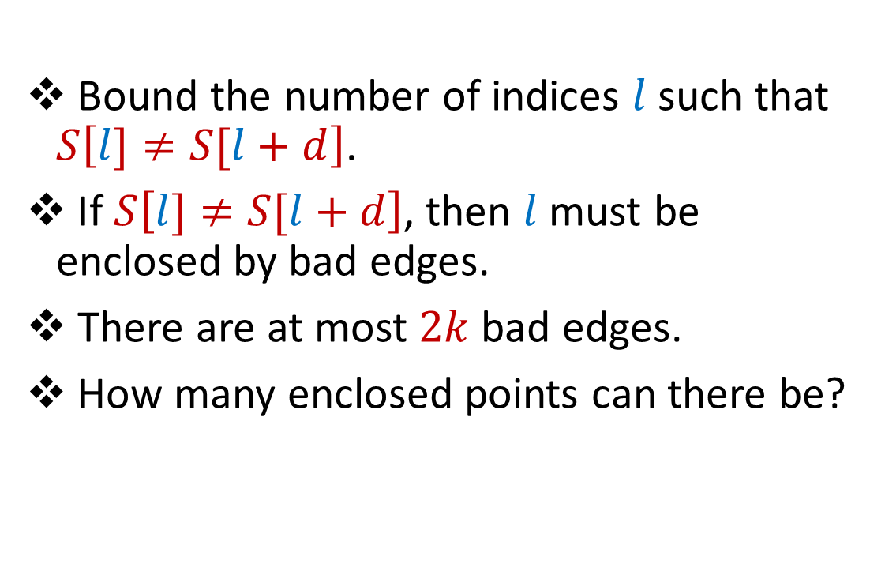
Structural Results
If there are at most $k$ indices $i$ such that $S\left[i]≠S[i+p\right],$ and at most $k$ indices $j$ such that $S\left[j]≠S[j+q\right],$ then there are at most $O(k^{2})$ indices $l$ such that $S\left[l]≠S[l+d\right]$.
$$i+p$$
$$i+p+q$$
Bound the number of indices $l$ such that $S\left[l]≠S[l+d\right]$.
If $S\left[l]≠S[l+d\right]$, then $l$ must be enclosed by bad edges.
There are at most $2k$ bad edges.
How many enclosed points can there be?
$$i−q$$
$$i$$
$$i+q$$
$$i−p$$

Slide 23
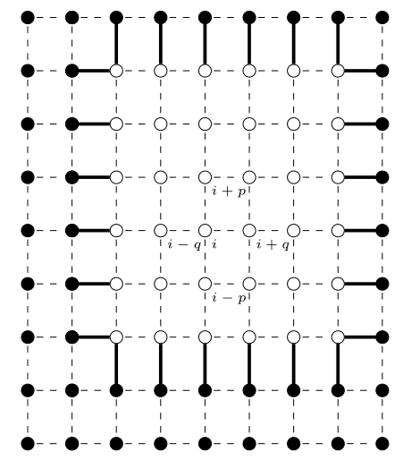
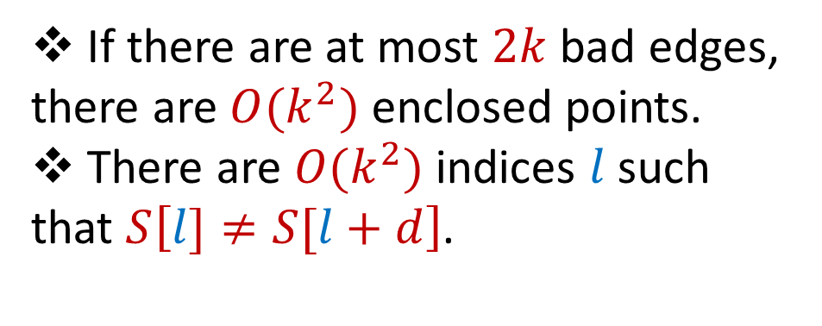
Structural Results
If there are at most $2k$ bad edges, there are $O(k^{2})$ enclosed points.
There are $O(k^{2})$ indices $l$ such that $S\left[l]≠S[l+d\right]$.

Slide 24


In review
If $p$ and $q$ are “small”, then $d=gcd(p,q)$ is a $O(k^{2})$-period.
Positions $p=\left\{8,16,20,27,30,39,45,55\right\}$?
Positions $p=\left\{8,12,16,20\},\left\{27,30,33,36,39\right\},\{45,50,55\right\}$

Slide 25
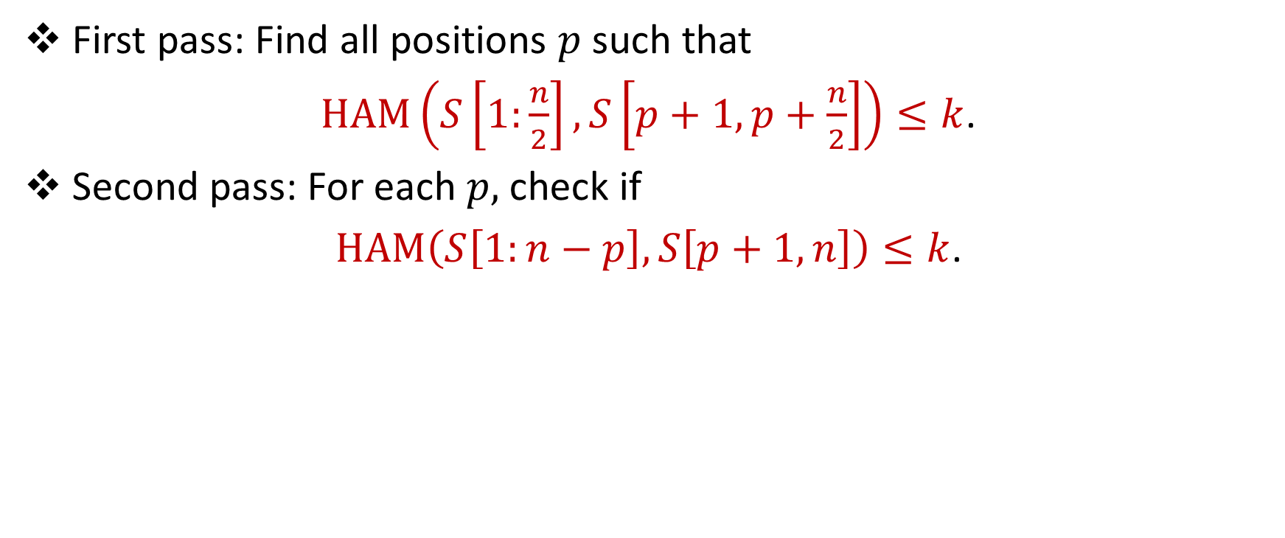
In review
First pass: Find all positions $p$such that
$HAM\left(S\left[1:\frac{n}{2}\right],S\left[p+1,p+\frac{n}{2}\right]\right)≤k$.
Second pass: For each $p,$ check if
$HAM\left(S\left[1:n−p\right],S\left[p+1,n\right]\right)≤k$.

Slide 26
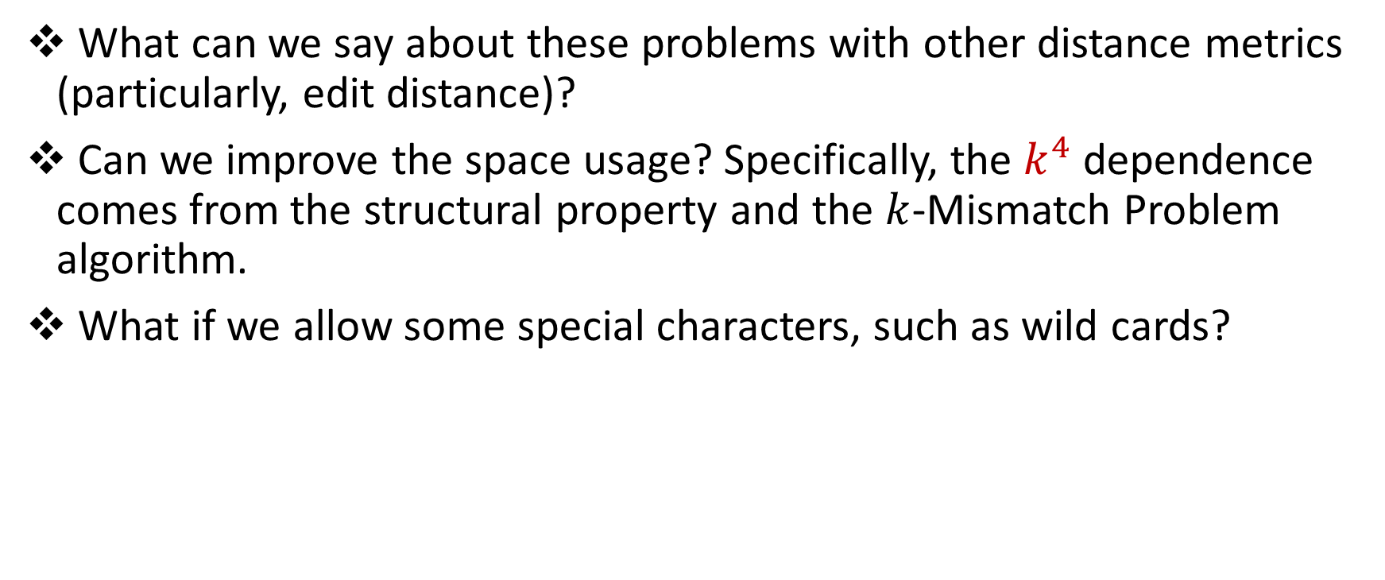
Open Problems
What can we say about these problems with other distance metrics (particularly, edit distance)?
Can we improve the space usage? Specifically, the $k^{4}$ dependence comes from the structural property and the $k$-Mismatch Problem algorithm.
What if we allow some special characters, such as wild cards?

Slide 27


Questions?

Slide 28
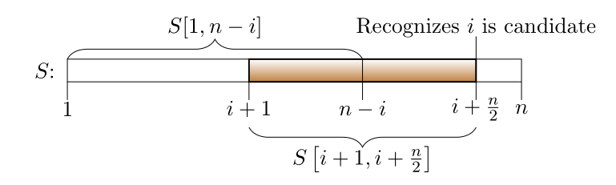
One-Pass

Slide 29
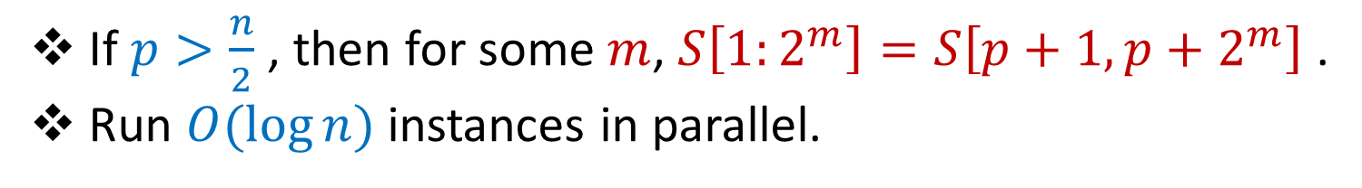
Larger Values and One-Pass Algorithm
If $p>\frac{n}{2}$ , then for some $m$, $S\left[1:2^{m}\right]=S\left[p+1,p+2^{m}\right]$ .
Run $O(\log{n)}$ instances in parallel.

Slide 30
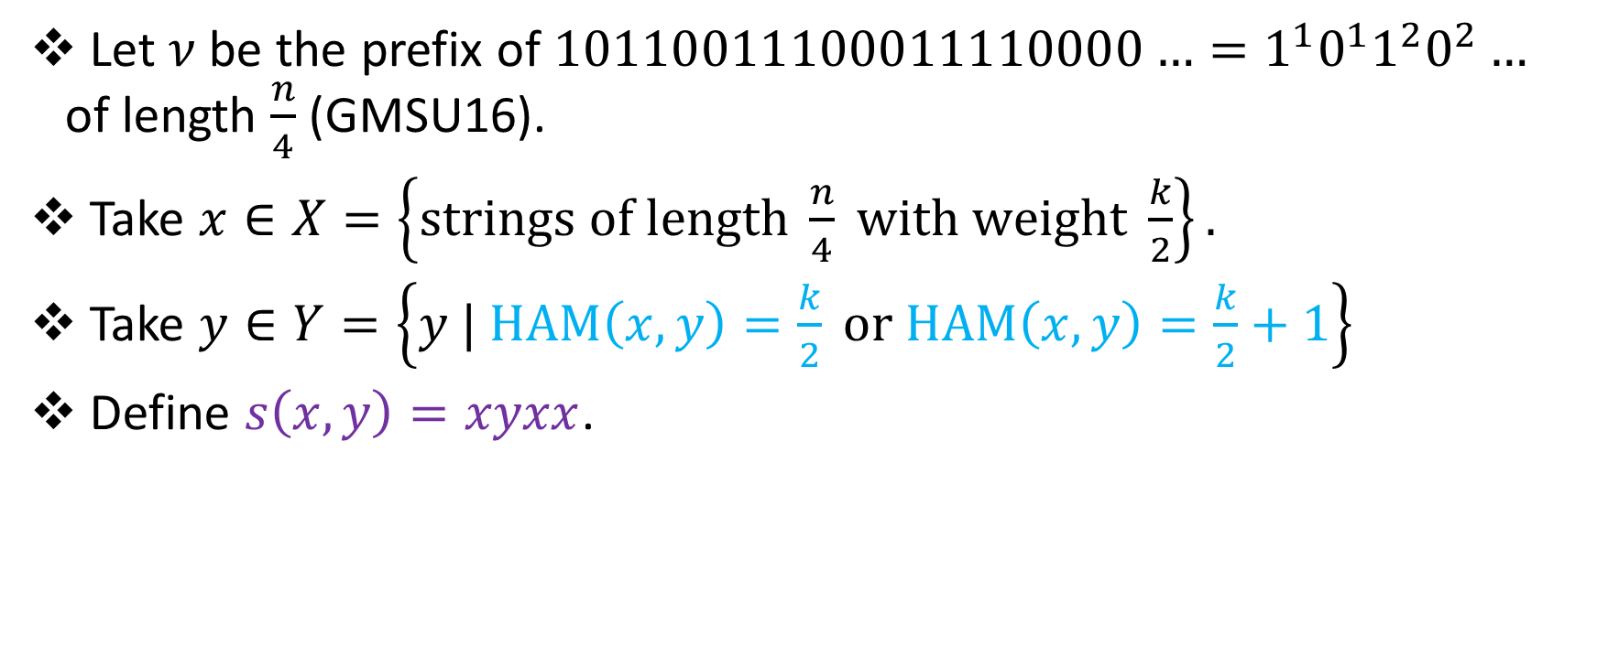
Lower Bounds
Let $ν$ be the prefix of $10110011100011110000…=1^{1}0^{1}1^{2}0^{2}…$ of length $\frac{n}{4}$ (GMSU16).
Take $x∈X=\left\{strings of length \frac{n}{4} with weight \frac{k}{2}\right\}.$
Take $y∈Y=\left\{y | HAM\left(x,y\right)=\frac{k}{2} or HAM\left(x,y\right)=\frac{k}{2}+1\right\}$
Define $s\left(x,y\right)=xyxx$.

Slide 31
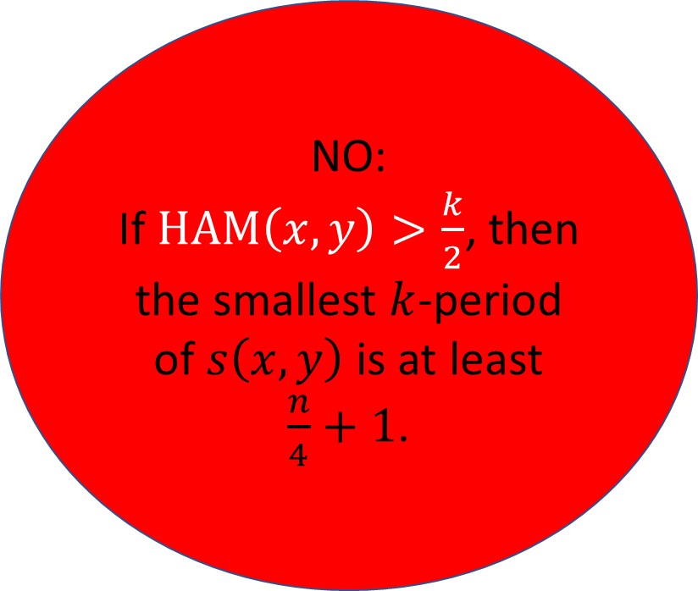
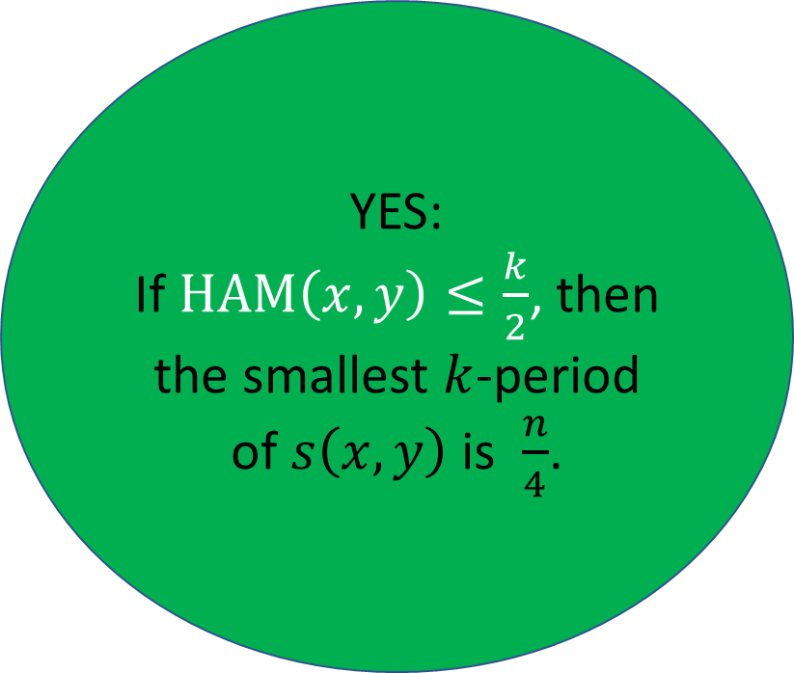
Lower Bounds
YES:
If $HAM\left(x,y\right)≤\frac{k}{2}$, then the smallest $k$-period of $s\left(x,y\right)$ is $\frac{n}{4}$.
NO:
If $HAM\left(x,y\right)>\frac{k}{2}$, then the smallest $k$-period of $s\left(x,y\right)$ is at least $\frac{n}{4}+1$.

Slide 32

Lower Bounds
Just need to show cannot differentiate whether $HAM\left(x,y\right)≤\frac{k}{2}$ or $HAM\left(x,y\right)>\frac{k}{2}$ in $o(k\log{n)}$ space!

Slide 33


Lower Bounds
Save $x$ in $\frac{k\log{n}}{6}$ bits.
Since $x∈X=\left\{strings of length \frac{n}{4} with weight \frac{k}{2}\right\}$, there are $\frac{|X|}{4}$ pairs $(x,x^{′})$ which are mapped to the same configuration.

Slide 34
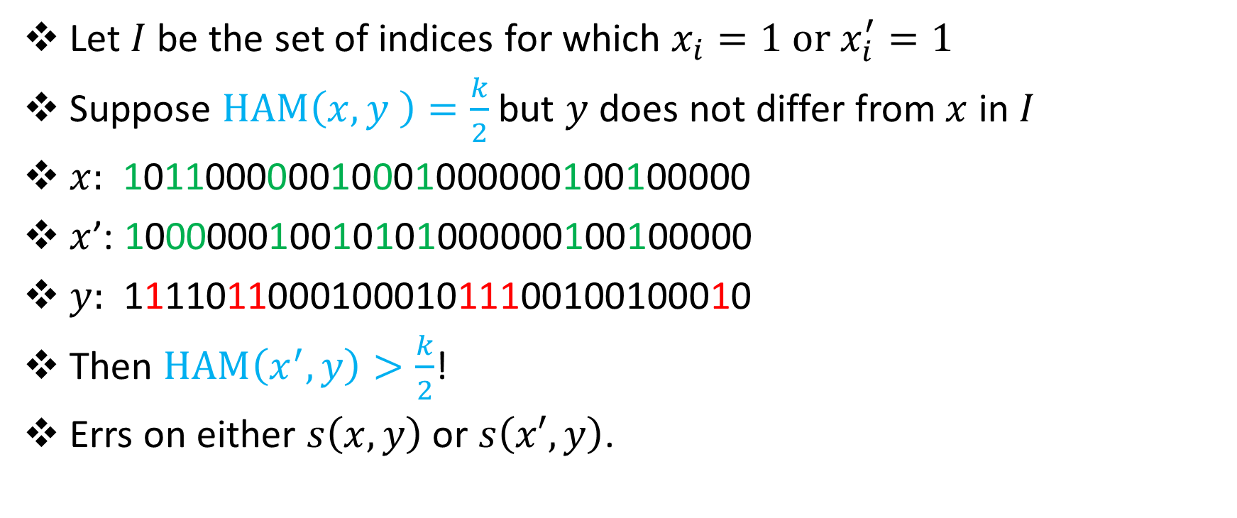
Lower Bounds
Let $I$ be the set of indices for which $x_{i}=1 or x_{i}^{′}=1$
Suppose $HAM\left(x,y \right)=\frac{k}{2}$ but $y$ does not differ from $x$ in $I$
$x:$ 101100000010001000000100100000
$x$’: 100000010010101000000100100000
$y:$ 111101100010001011100100100010
Then $HAM\left(x^{′},y\right)>\frac{k}{2}$!
Errs on either $s\left(x,y\right)$ or $s\left(x′,y\right)$.
???

Slide 35
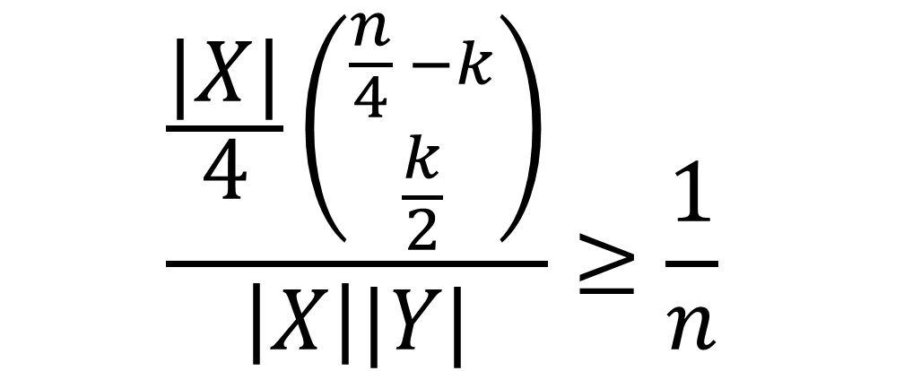
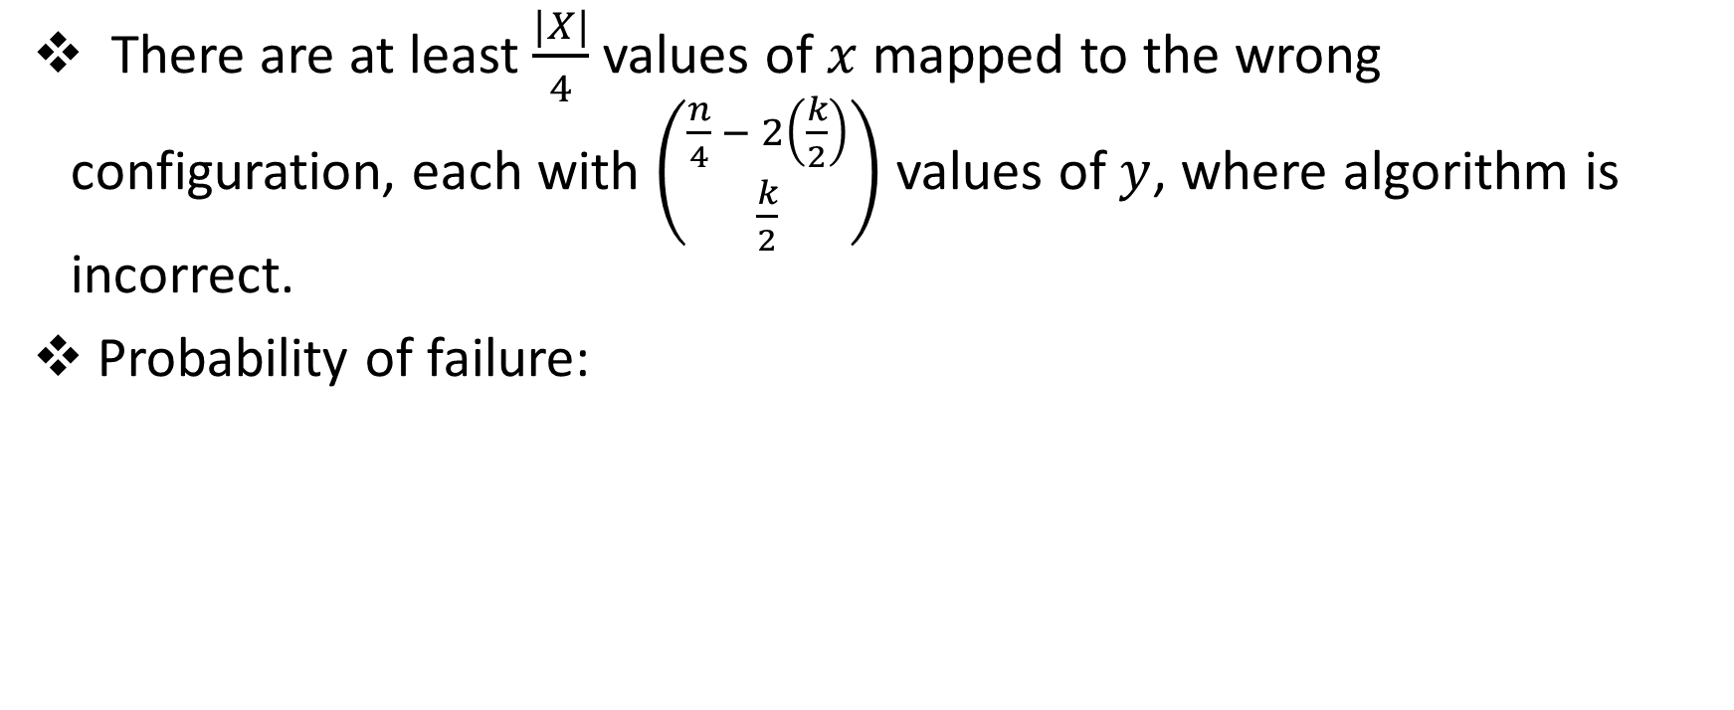
Lower Bounds
There are at least $\frac{|X|}{4}$ values of $x$ mapped to the wrong configuration, each with $\left({\frac{n}{4} − 2\left(\frac{k}{2}\right) \atop \frac{k}{2}}\right)$ values of $y$, where algorithm is incorrect.
Probability of failure:
$$\frac{\frac{|X|}{4}\left({\frac{n}{4} −k \atop \frac{k}{2}}\right)}{\left|X\right||Y|}≥\frac{1}{n}$$

Slide 36
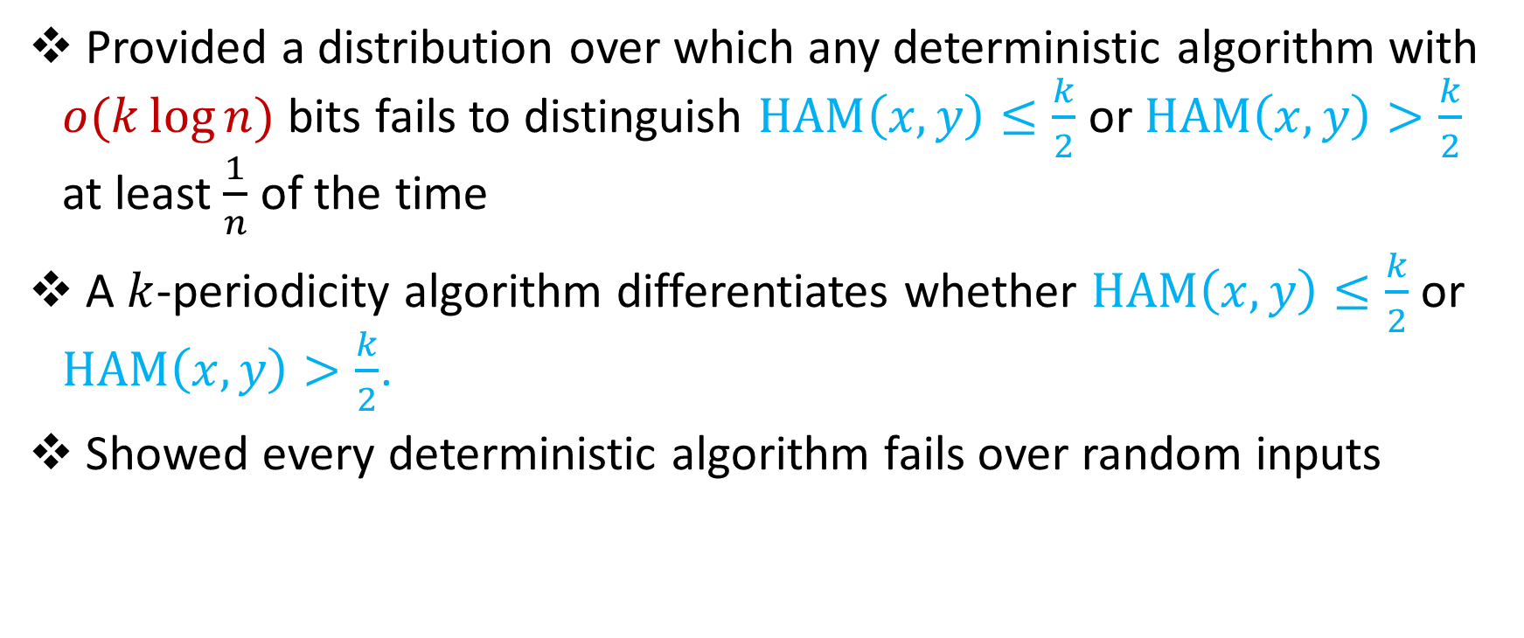
In review
Provided a distribution over which any deterministic algorithm with $o(k\log{n)}$ bits fails to distinguish $HAM\left(x,y\right)≤\frac{k}{2}$ or $HAM\left(x,y\right)>\frac{k}{2}$ at least $\frac{1}{n}$ of the time
A $k$-periodicity algorithm differentiates whether $HAM\left(x,y\right)≤\frac{k}{2}$ or $HAM\left(x,y\right)>\frac{k}{2}$.
Showed every deterministic algorithm fails over random inputs

Slide 37
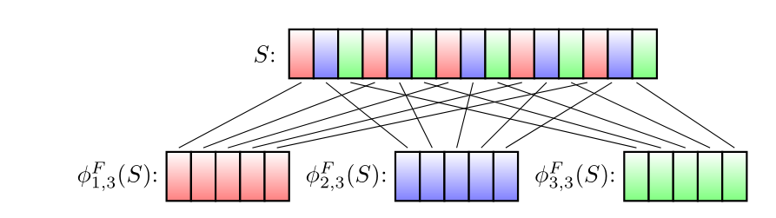
Karp-Rabin Fingerprints for subpatterns (CFP+16)
$S_{a,b}=S\left[a\right]S\left[a+b\right]S\left[a+2b\right]S\left[a+3b\right]…$
$φ_{a,b}\left(S\right)=φ\left(S_{a,b}\right)=B∗S\left[a\right]+B^{2}∗S\left[a+b\right]+B^{3}∗S\left[a+2b\right]…$

Slide 38



Identifying Mismatches?
What about
$HAM\left(S,T \right)≤2k$?
Sample $\log{n}$ primes $p_{1},p_{2},…$ from $\left[16 k\log^{2}{n, 544 k\log^{2}{n}}\right]$.
Let $∆ =max \#\left\{a \right|{ φ}_{a,p_{i}}\left(S\right)≠{B^{k}φ}_{a,p_{i}}^{R}\left(S\right) (mod P)\}$
$∆ ≤HAM(S,T)$
If $HAM\left(S,T\right)>2k$, then $∆ >\left(1+\frac{1}{16}\right)k$ w.h.p. (CFP+16)

Slide 39
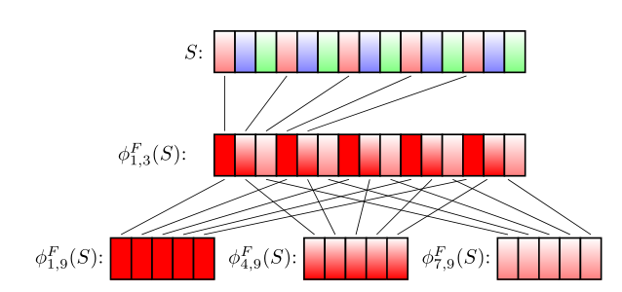
Karp-Rabin Fingerprints for sub-subpatterns

Slide 40


Second level Karp-Rabin Fingerprints
Call a mismatch isolated under $p_{i}$ if it is the only mismatch under some subpattern $S_{a,p_{i}}$. Let $I$ be the number of isolated mismatches.
If $HAM\left(S,T\right)≤2k$, then $I=HAM\left(S,T \right)$ w.h.p. (CFP+16)

Slide 41

Properties of Karp-Rabin Fingerprints
$φ\left(S[1:y]\right)=φ\left(S[1:x]\right)+B^{x}φ\left(S[x:y]\right)$ (sliding)
Define $φ^{R}\left(S\right)=\sum_{i=1}^{n}{B^{−i}S\left[i\right] \left(mod P\right)}$
$φ\left(S^{R}[1:x]\right)=B^{x+1}φ^{R}\left(S[1:x]\right)$ (reversal)
$φ^{R}\left(S[1:y]\right)=φ^{R}\left(S[1:x]\right)+B^{−x}φ^{R}\left(S[x:y]\right)$

